Slide 1


Attention Restoration Theory - how does time influence the outcome?

Slide 2
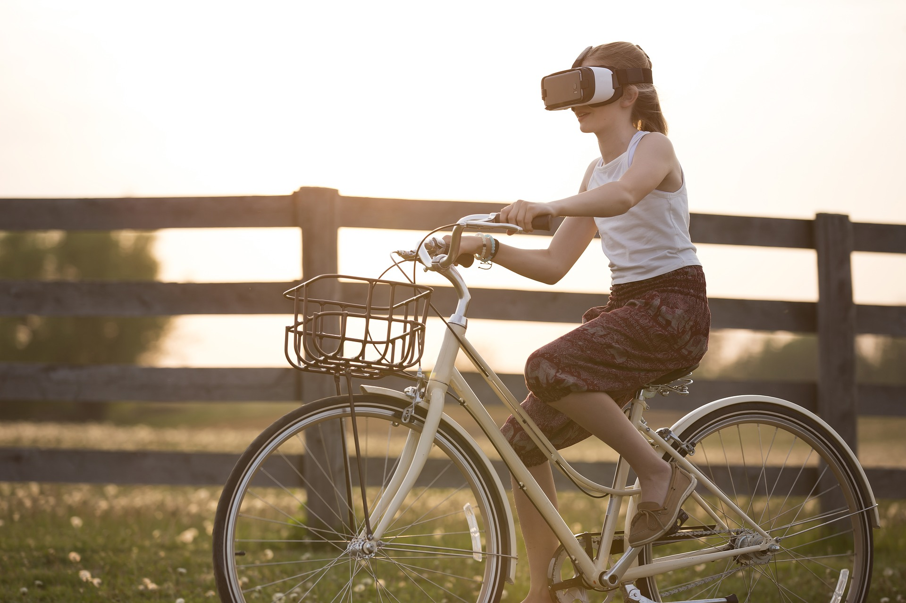
Back to Nature
Project Review and Feedback
Research Practicum
IDS6916
Andres Hanchi
Markus Loennig
Marc Mailloux

Slide 3




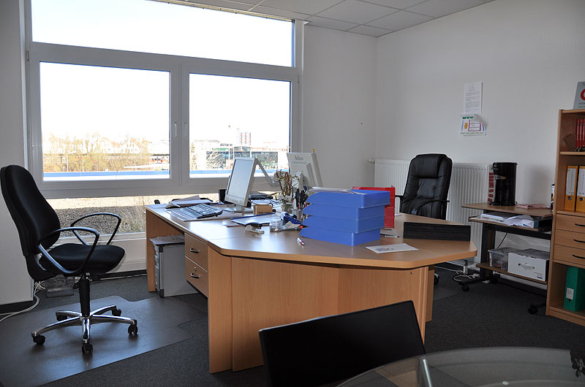
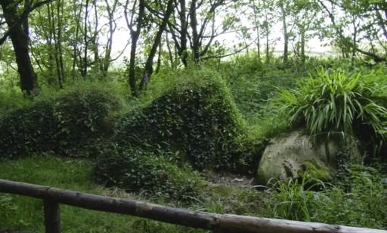
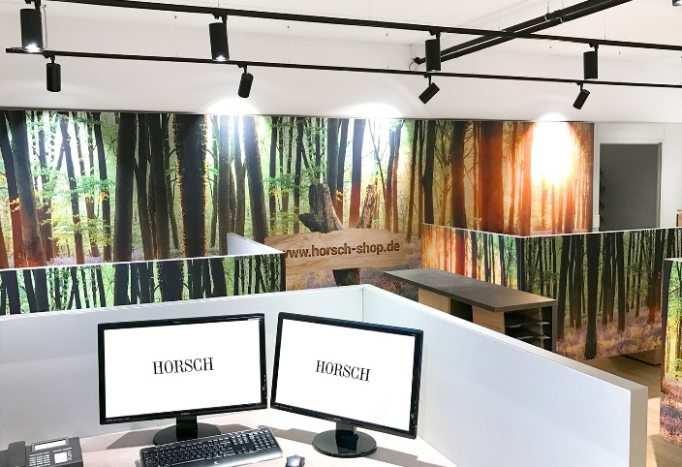
Back to Nature
Project Review and Feedback
Research Practicum
IDS6916
Andres Hanchi
Markus Loennig
Marc Mailloux

Slide 4

Topic / Purpose Statement
Studies on Attention Restoration Theory (ART) has shown positive effects that Nature can have on attention restoration
But: researchers arbitrarily decided the length of exposure time (usually 15 minutes or more)
Our goal:
study the length needed to show measurable effects of Nature exposure through Virtual Reality (VR)
Notes:
Our goal is to restore one’s attention in less than the standard 15 minutes used in previous studies.

Slide 5

Introduction
Today’s fast pace can have a negative effect on attention
Directed attention is important for productivity and mental stability
Several studies based on ART have validated the positive effects that nature and/or nature scene exposure can have on one’s attention and its restoration.
Notes:
Understanding the time needed to restore attention is vital

Slide 6
Related Works / Literature Review
In 1995 Dr. Kaplan to find an integrated theory of stress that permits a significant role for attention. The proposed framework differentiated the two components, stress and attention, since they both benefit from restorative nature experiences
Notes:
You may not realize but you actually know at least one of his designs: Central Park

Slide 7
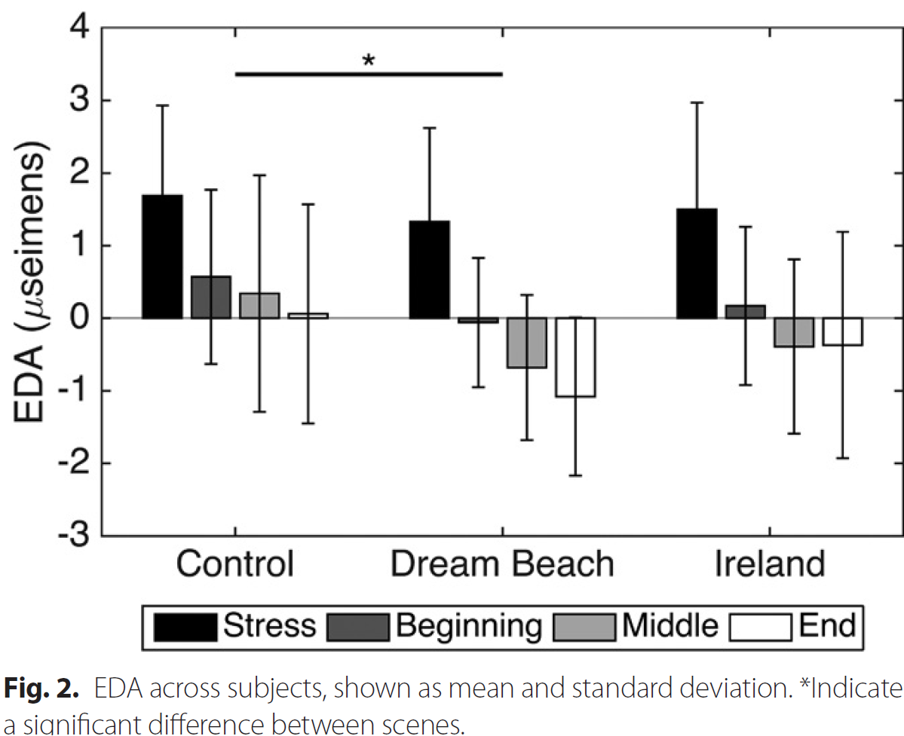
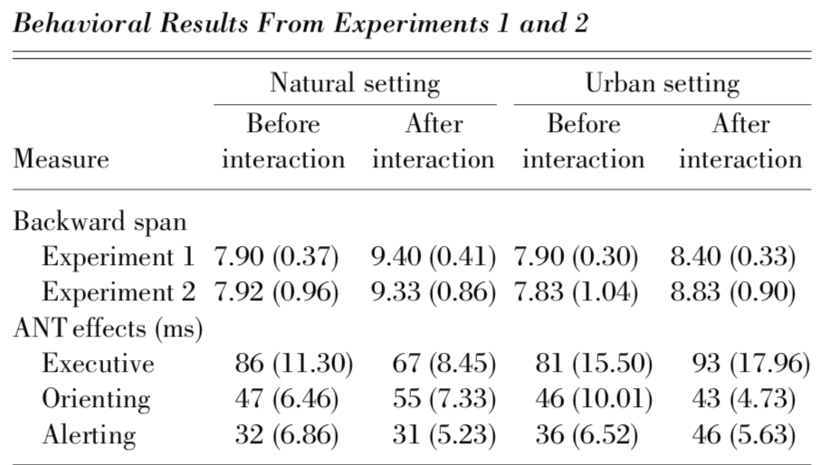
Related Works / Literature Review
2017 A. Anderson
effects of VR nature exposure on stress
2 experiments
Experiments provided different results due to participants perception of stress
2008 M. Berman
effects of nature and urban exposure on attention
2 experiments
Experiments provided validation of ART with participants in nature and viewing nature by photos

Slide 8

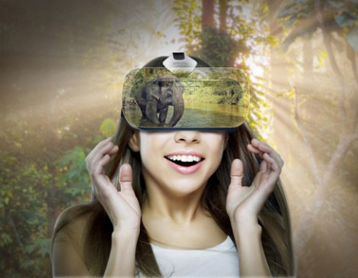
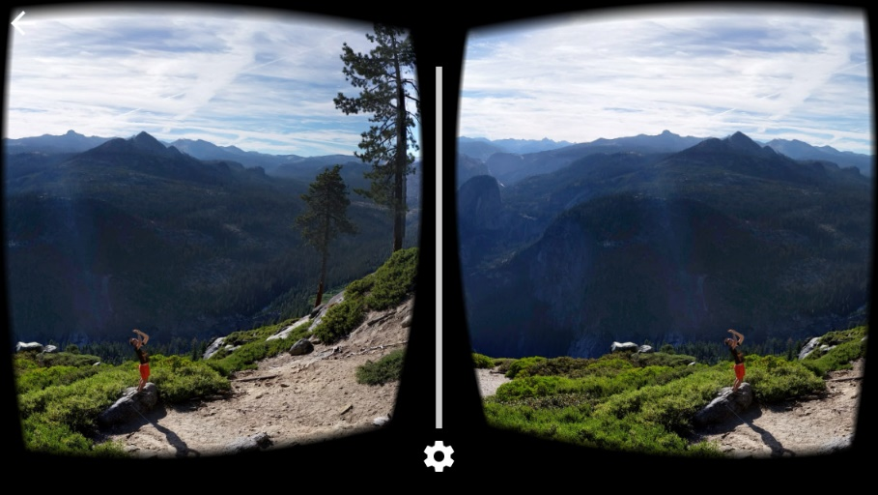
Research Question
Can we measure positives effects for attention restoration on individuals exposed to nature scenes delivered through Virtual Reality at 10 or less minutes?
Notes:
Based on the results from studies conducted on Attention Restoration Theory
These studies, exposed participnats to nature scenes using random lengths of time
Our research question is:

Slide 9

Research Method
For this study our group will conduct an experiment
A combination of surveys and interactive test will be administered to assess attention
Quantitative data will be gathered and analysed

Slide 10
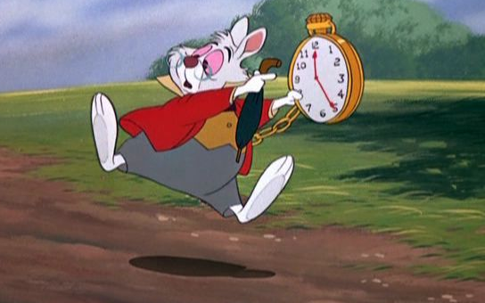
Hypothesis
Exposure to nature scenes through VR can
restore one’s attention in less than 15 minutes

Slide 11
Preliminary Framework / Setup
PANAS | DSSQ | 2-Back test | Vigilance tasks | PANAS | 2-Back test | VR Session | 2-Back test | PANAS | DSSQ
Emotional baseline |  | Cognitive baseline | Attention depletion | Emotional state | Cognitive performance | Restoration | Cognitive performance | Emotional sate
4 min
8 min
30 min
1 min
8 min
15 min
8 min
4 min
10 min
8 min
none

Slide 12
Preliminary Framework / Setup
The participants will be provided PANAS and DSSQ to assess mood and anxiety
Then the 2 back test be administered to establish the baseline
Participants will take the vigilance task assess attention
Another PANAS assessment will be conducted
The 2-back test will be administered again
PANAS | DSSQ | 2-Back test | Vigilance tasks | PANAS | 2-Back test | VR Session | 2-Back test | PANAS | DSSQ

Slide 13
Preliminary Framework / Setup
The 2-back test will be administered again
The participants will be expose to nature scenes provided by a VR headset
The 2-back test will be administered again
The participants will be provided PANAS and DSSQ to assess mood and anxiety
PANAS | DSSQ | 2-Back test | Vigilance tasks | PANAS | 2-Back test | VR Session | 2-Back test | PANAS | DSSQ

Slide 14
Preliminary Framework / Setup
The 2-back test will be administered again
The participants will be expose to nature scenes provided by a VR headset
The 2-back test will be administered again
The participants will be provided PANAS and DSSQ to assess mood and anxiety
PANAS | DSSQ | 2-Back test | Vigilance tasks | PANAS | 2-Back test | VR Session | 2-Back test | PANAS | DSSQ

Slide 15
Preliminary Framework / Setup
PANAS | DSSQ | 2-Back test | Vigilance tasks | PANAS | 2-Back test | VR Session | 2-Back test | PANAS | DSSQ
Emotional baseline |  | Cognitive baseline | Attention depletion | Emotional state | Cognitive performance | Restoration | Cognitive performance | Emotional sate
4 min
8 min
30 min
1 min
8 min
15 min
8 min
4 min
10 min
8 min
none

Slide 16
Preliminary Framework / Setup
PANAS
PANAS
PANAS
DDSQ
DDSQ
2back
Vigilance
2back
VR
2back

Slide 17

Preliminary Framework / Setup
The experiment will be conducted 1 week apart with the same participants using different time intervals
Qualtrics will be used to record responses and transform data into excel like format
Data Analysis will be conducted using R-software
Notes:
Data will be analysed against expected results from Hypothesis.

Slide 18
Plan of Attack / Rough Deliverables
The VR headset has been allocated
The software used for the VR nature scenes has also been identified
PANAS and DDSQ forms have been downloaded
Access to 2-back test and Vigilance task test is being worked on.
Next is to start narrowing down the selection of participants
Identify the location of the experiment

Slide 19

Questions ?

